Slide 1
Lecture 1
Stochastic processes: Some important probability theorems
Statistical computing: The probability Integral Transform, generating normal rv’s

Slide 2
Overview of important limit theorems
Laws of Large Numbers (LLN):
They are concerned with stating conditions, under which the average of (or sequence of) random variables converges, in some sense, to the expected average.
Central Limit Theorem (CLT):
Concerned with determining conditions under which the sum of a large number of random variables has a probability distribution that is approximately normal.

Slide 3
Markov’s Inequality
Chebyshev’s Inequality
CLT
SLLN

Slide 4
The Probability Integral Transform:
Use of a U(0,1) rv and an inverse CDF to generate other rv’s
Proof
Examples (Gamma and Beta)

Slide 5
Example: Generate a Beta(1,6) distribution
U<-runif(6000,0,1)
U<-matrix(U,6,1000)
E1<--log(U)
u1<-E1[1,]
u2<-apply(E1,2,sum)
B.16<-u1/u2
plot(density(B.16))
hist(B.16,breaks=20)

Slide 6
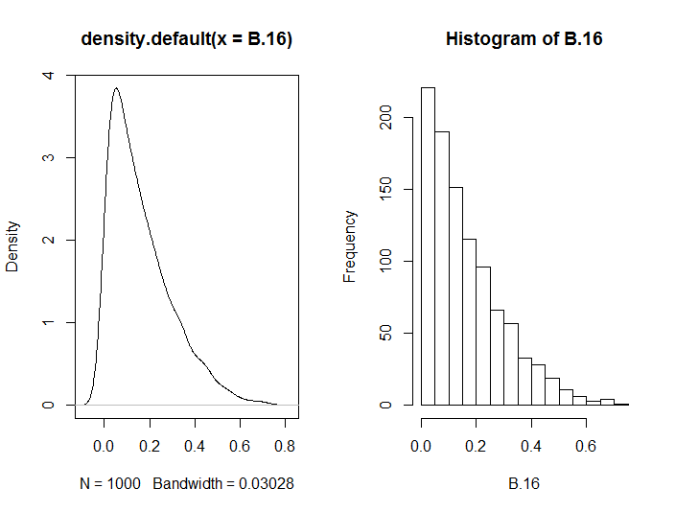

Slide 7
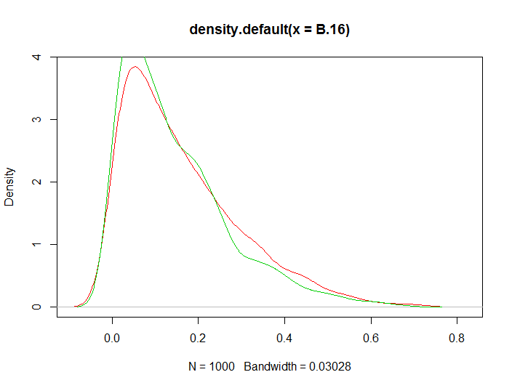
b16<-rbeta(1000,1,6)
plot(density(B.16),col=2)
lines(density(b16),col=3)

Slide 8
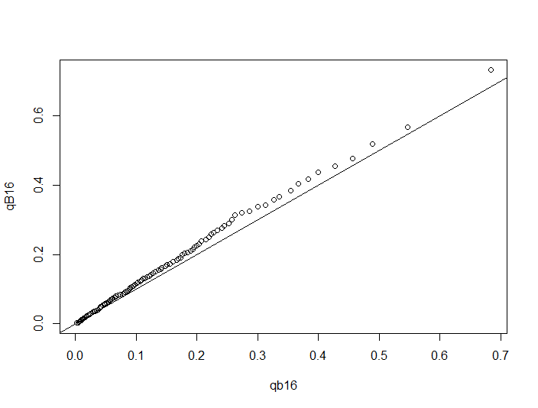
##compare the two generated distributions
qB16<-quantile(B.16,seq(0.01,1,0.01))
qb16<-quantile(b16,seq(0.01,1,0.01))
plot(qb16,qB16,type="p")
abline(0,1)

Slide 9
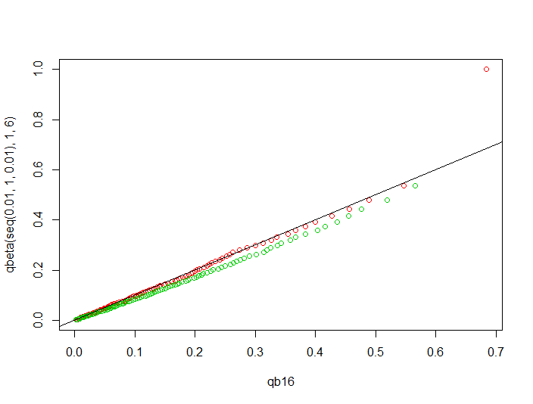
##compare each generated dist to the theoretrical distribution
plot(qb16,qbeta(seq(0.01,1,0.01),1,6),type="p",col=2)
points(qB16,qbeta(seq(0.01,1,0.01),1,6),type="p",col=3)
abline(0,1)

Slide 10
Generating Normal rv’s
R normal generator
Box-Muller transformation derivation

